Slide 1
Single Page Application (SPA) paradigm

Slide 2
What is SPA?
A single-page application (SPA) is a web application or web site that fits on a single web page with the goal of providing a user experience similar to that of a desktop application. In an SPA, either all necessary code – HTML, JavaScript, and CSS – is retrieved with a single page load, or the appropriate resources are dynamically loaded and added to the page as necessary

Slide 3
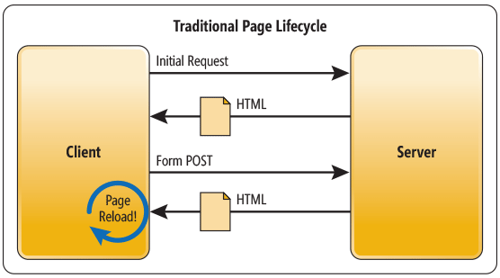
Multi-page Website (MPW)

Slide 4
 | JSP
Template engines | Thymeleaf + thymeleaf-layout-dialect
 | Freemarker
 | Velocity
Layout engines | Apache Tiles
 | SiteMesh

Slide 5
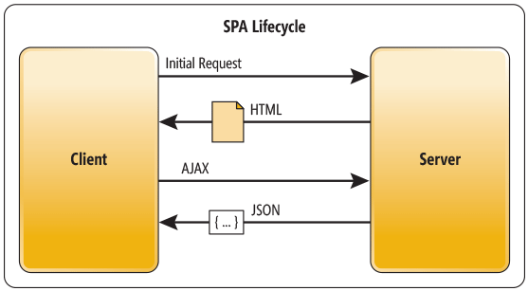
In an SPA, after the first page loads, all interaction with the server happens through AJAX calls.

Slide 6
SPA benefits
Applications are more fluid and responsive
AJAX requests plus JSON responses makes clean separation between the presentation (HTML markup) and application logic
As a result with this architecture, the client and the service are independent.
You could replace the entire back end, and that won’t break the client.
The reverse is also true—you can replace the entire client app without changing the service layer.

Slide 7
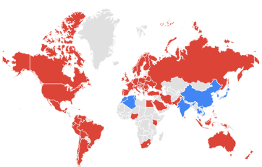
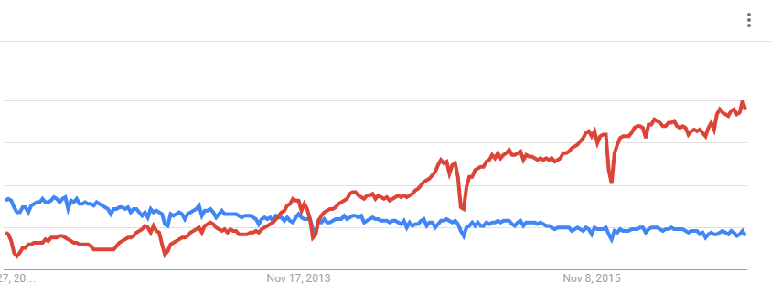
JSP vs. Angular

Slide 8
We already used at least two SPA frameworks such as:
Isomorphic Js
ExtJs
The problem is that in most cases we were completely ignored SPA paradigm for which those frameworks were introduced. Instead we render new page on almost every request, moreover every page reload javascript framework. Even most of browsers supports static resource caching it doesn’t make such approach optimal.
We haven’t use
Angular 2

Slide 9
Proof of concept Mock project
Why we need it
Experiment = proof
Ready to go template project
Study new technologies
Mock project demonstrate spring security
UI front-end for site administrators and business analysts based on ExtJs framework
UI front-end for clients and visitors based on Angular 2

Slide 10
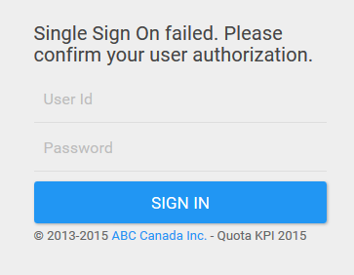
From Login page depending of user role login module will forward user to either admin or client view.

Slide 11
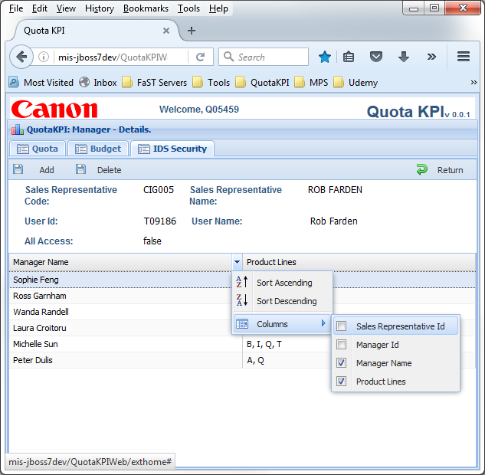
Admin view
Admin view allow site admin or business analysts work as they would in desktop application

Slide 12
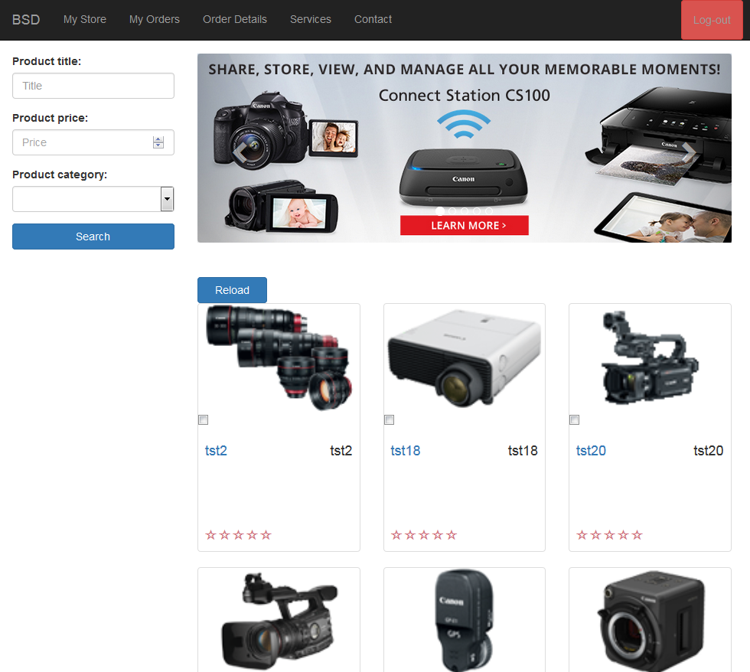
Client view
Client view has almost traditional web page look and feel, but in our project we use modern Angular 2 framework which is as close to SPA as ExtJs site

Slide 13
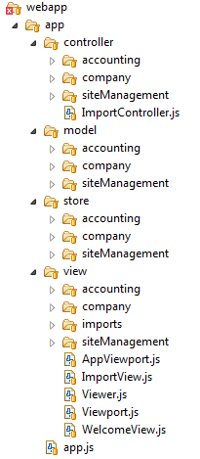
Regular project structure for ExtJs app with default folder names

Slide 14
Root application folder is what you expect ‘app’
‘view’ folder for all visual components
‘model’ folder contains all entities. These models/ entities are twins siblings to their server side counterparts.
‘controller’ folder contain all application controllers. Because SPApplication may provide rich behavior it require controllers which handle full components life cycle.
And last folder ‘store’ which contains all datasources for application components

Slide 15
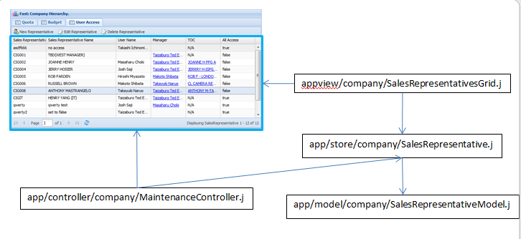
How MVC parts works together

Slide 16
Angular 2 features
Mobile - Angular focuses on the development of mobile apps
Modern - Angular 2 target ES6/typescript next generation of javascript and “evergreen” modern browsers (those automatically updated to the latest version)
Modular – No need to load Angular 2 framework as one piece. Load only required modules.
Components Over Controllers - Unlike AngularJs and ExtJs Angular's main building block is a Component (custom element with its own html tag, controller, view declared inside)
Improved Data Binding
Support for Functional Reactive Programming paradigm.
Routing – improved page flow

Slide 17
My favorite is “Components Over Controllers”.
“Learning a framework should start with one of the most important building blocks, which, in the case of Angular 2 apps, is components. It makes the framework easier to learn and use.”
Now we can say that Component literally is autonomous building block of Angular 2 UI layer.
No more controllers. Everything handled by component.

Slide 18
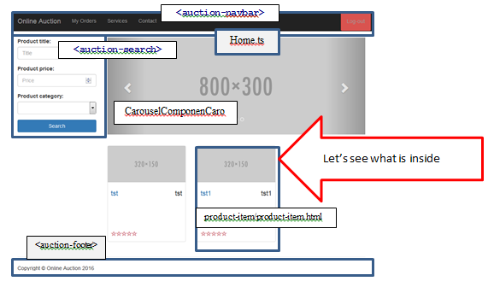
Everything you see on page is components, and components as composition of components.

Slide 19
Let’s see what is inside product-item component
001: import { Component, Input } from '@angular/core'; <- Import what we need from core
002: import { Product } from '../../services/product-service'; <- Import what we need from service
003:
004: @Component({
005: selector: 'auction-product-item', <- Define HTML tag <auction-product-item>
006: styleUrls: [ 'resources/app/components/product-item/product-item.css'], <- Link to CSS
007: templateUrl: 'resources/app/components/product-item/product-item.html' <- Link to HTML view
008: })
009: export default class ProductItemComponent { <- Controller class for this component
010: @Input() product: Product;
011:
012: constructor() {
013: }
014: }

Slide 20
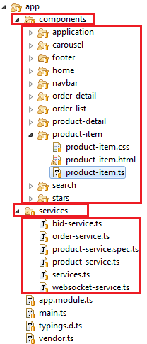
Project structure for Angular 2

Slide 21
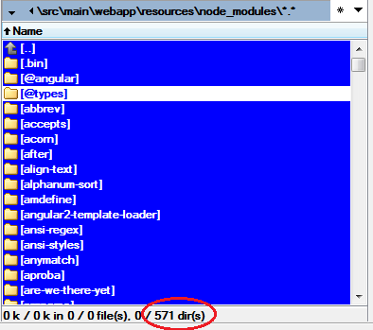
Deployment of Angular 2 application
You would be surprised how many packages Angular2 framework depends from

Slide 22
“webpack” deploy bundle
Lot of bundlers available
Browserify,
Webpack,
Broccoli
Rollup
Webpack is the simplest
Angular 2 team works close to Webpack team

Slide 23
Build bundle with NPM
Use NodeJs package manager
Include build script into package.json
"scripts": {
"build": "webpack",
}
By default webpack reads its own configuration from webpack.config.js
Run
MockWebExtJs6_bsd\src\main\webapp\resources>npm run build

Slide 24
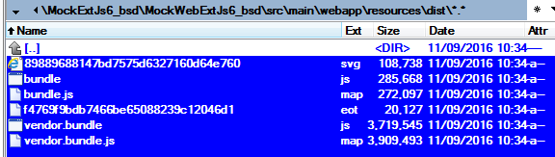
When build completed our application bundled in two small bundles

Slide 25
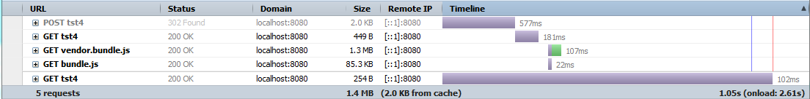
Page load traffic and time looks much better after that:

Slide 26
Styling Application
In the beginning of July 2015, Google publicly released a new framework that is easy to use and has no additional dependencies. It’s called Material Design Lite (MDL for short).
We’ll see how developers accept it.

Slide 27
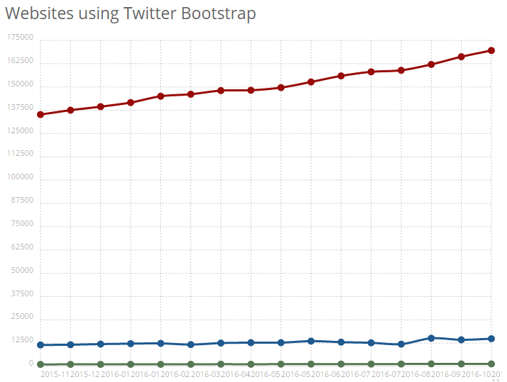
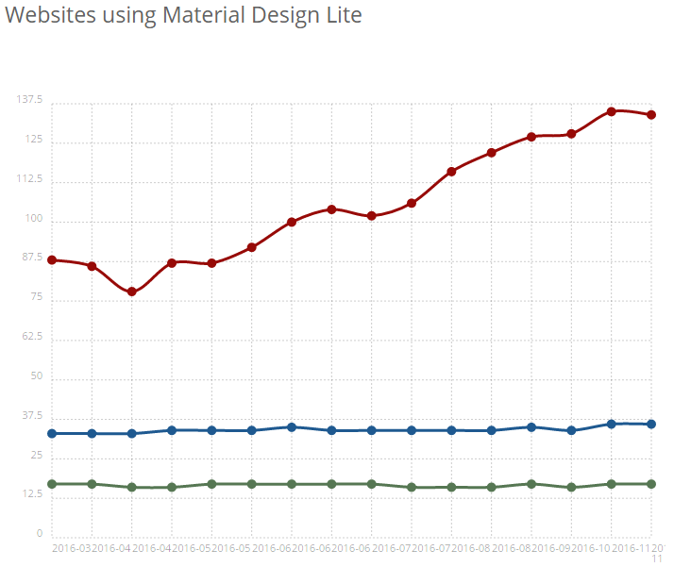
Google ‘bootstrap vs. mdl’

Slide 28
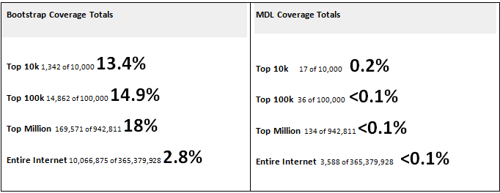
“Build with” stats

Slide 29
Styling Application with Bootstrap
There many ways to customize bootstrap, but we can narrow them to just three.
Easiest one is to customize bootstrap distributive online (plenty of resources to choose)
Override styles in static CSS included after bootstrap core
Override through Less files

Slide 30
Customizing Bootstrap Using CSS
In \index.html
<link rel="stylesheet" type="text/css" href="css/bootstrap.css">
<link rel="stylesheet" type="text/css" href="css/app.css">
In \css\app.css we override main CSS styles
.btn{
border-radius: 0;
padding: 5px 10px;
font-size: 16px;
}
.btn-primary{
background: #63AEF0;
}

Slide 31
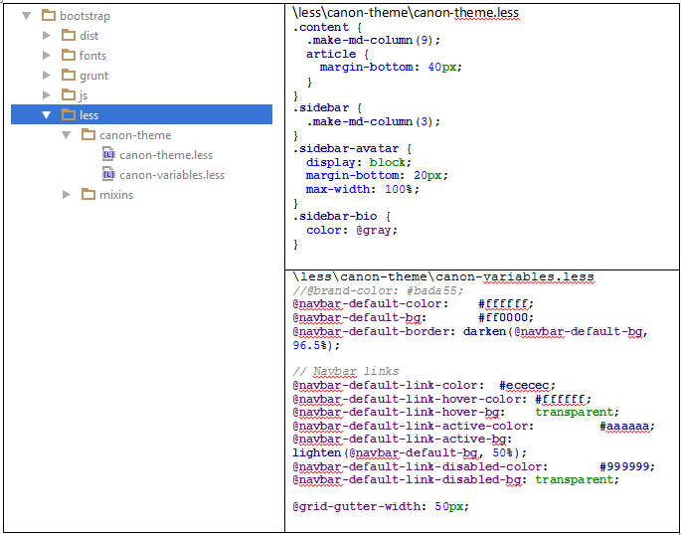
Override through Less files

Slide 32
Import them in root less file
less\bootstrap.less_
@import "canon-variables.less"; @import "canon-theme.less";
Run build
bootstrap>grunt dist

Slide 33
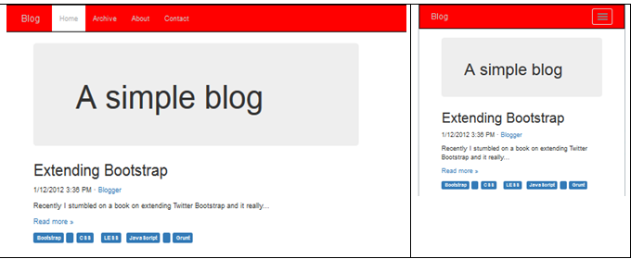


Project for Canon custom bootstrap distributive

Slide 34
Project CVS repository
You may find source code for project I’ve referred in this document in CVS repository:
mis-cvs-v:/CCI_SOurceCodes_Repo/MockExtJs6_bsd

